Slide 1
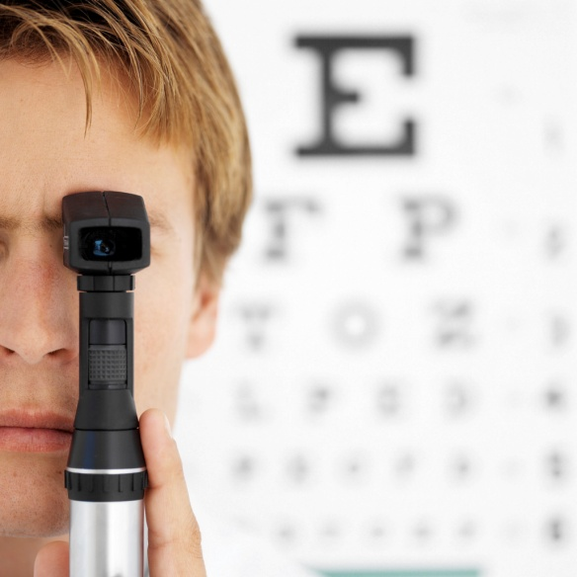

Physical Examination

Slide 2
Objectives
Overview of a physical examination
Basis for big system assessments including lymph node assessment
Practice

Slide 3
Initial Approach
Approach patient with confidence
Introduce yourself
Explain you are a student and may take extra time
Gain verbal consent
Ensure good lighting
Ensure the patient is comfortable and safe
BE SYSTEMATIC!
Always examine from the right hand side

Slide 4
2 types of Examination
Full Exam- student nurse practitioners/Medical students
Focused Exam – Brief
Experienced practitioners in Physical examination
Emergency

Slide 5
4 Main Techniques
Inspection - Look
Palpation - Feel
Percussion - Tap
Auscultation - Listen

Slide 6
2 others
Special manoeuvres – position, technique
Range of Motion – normal/abnormal

Slide 7

Inspection
Begins as soon as you meet the patient
General appearance –age, sex, race, body build, alert , orientated, anxious, in pain
Distressed cardiac or respiratory
Deformities – compare sides
Obvious distinguishing characteristics

Slide 8
Inspection cont
Ensure good light
Ensure proper exposure of area to be examined
May need instruments to enhance view

Slide 9
Palpation
Use of different areas of the hand
Light
Deep
May be used to confirm something you have noticed on inspection

Slide 10
Feel for:
Temperature
Texture
Size
Shape
Firmness – soft, hard, spongy (fluid filled)
Organ span

Slide 11

Percussion
Used to illicit sounds
Identify location of organs or mass
Identify air/fluid/solid filled areas
Needs practice! – technique and sound identification

Slide 12
Percussion notes
Sound | intensity | pitch | duration | Example of location
Flatness | soft | high | short | Thigh
Dullness | Medium | medium | medium | Liver
Resonance | loud | low | long | Normal lung
Hyper-resonance | Very loud | Lower | Longer | No example
Tympany | loud | high |  | Gastric air bubble or puffed out cheek
Bickley and Szilagyi 2009

Slide 13

Auscultation
TAKES TIME AND PRACTICE!
Not as difficult as you think
Main points are : Normal/Abnormal
How important are the abnormal?
Use stethoscope properly
Remember high pitched = diaphragm
Low pitched= bell

